Slide 1
Pattern Matching Algorithm in C Pattern Matching algorithms are used to search for patterns within a larger text or data set. These algorithms work by comparing a pattern with a larger data set or text and determining whether or not the pattern is present. Pattern Matching algorithms are important because they allow us to search for patterns in large data sets quickly. Uses of pattern matching: Applications of pattern matching include identification of phrases within the larger text, finding specific shapes within an image, distinguish sound patterns in the spoken language, search all instances of a particular gene within the larger set of DNA sequences, etc.

Slide 2
C Program for Naive algorithm for Pattern Searching Input: text = “AABAACAADAABAABA”, pattern = “AABA” Output: Pattern found at index 0, Pattern found at index 9, Pattern found at index 12 It avoids unnecessary comparisons by skipping some positions in the text. The algorithm starts comparing the pattern with the text at the first position. If the characters match, it moves to the next position and repeats the comparison. If the characters do not match, the algorithm moves to the next position in the text and compares the pattern with the text again.

Slide 3
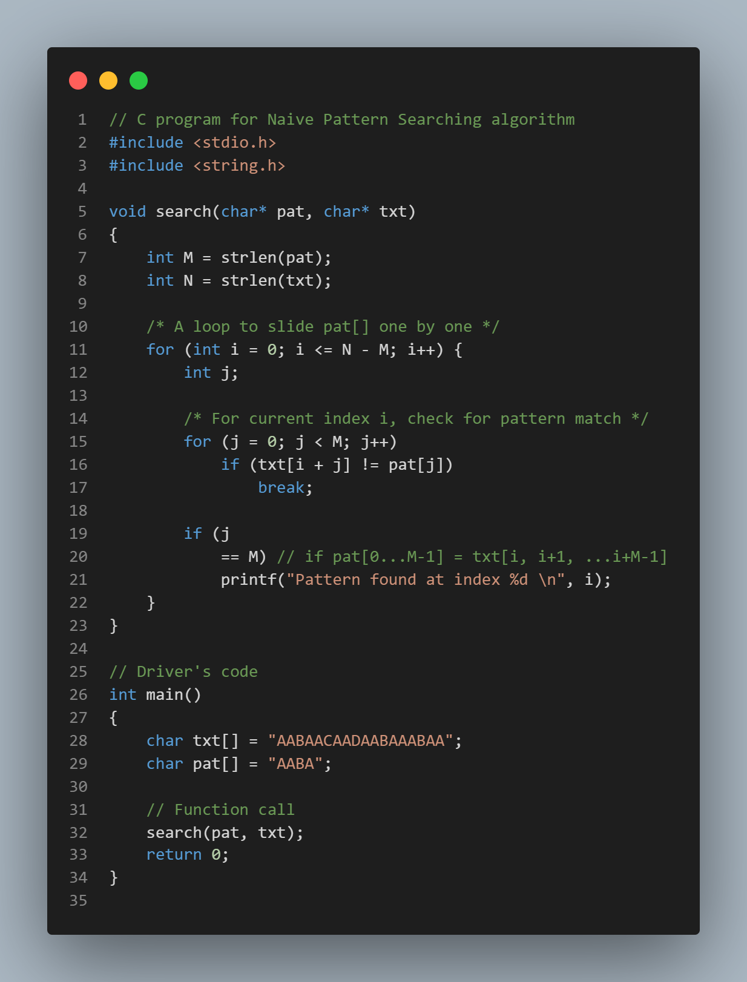

Slide 4
Knuth-Morris-Pratt Algorithm: The Knuth-Morris-Pratt (KMP) algorithm is a more advanced Pattern Matching algorithm. he KMP algorithm is a solution to the string search problem wherein we are required to find if a given pattern string occurs in another main string. It is one of the advanced string matching algorithm that was conceived by Donald Knuth, James H. Morris and Vaughan Pratt, hence the name "KMP algorithm". The algorithm keeps a track of the comparison of characters between main text and pattern, thereby ensuring that comparisons that have already been done are not repeated, i.e. backtracking of the main string never occurs. All this results in a linear matching time and a more optimized solution. The Time Complexity of the KMP algorithm is O(M+N).

Slide 5
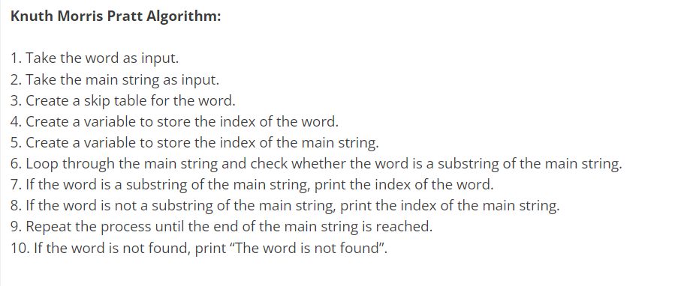
Example: Input: Main String: "ABAAABAAAAABBAAAABA", Pattern: "AAAB" Output: Pattern found at location: 2 Pattern found at location: 8 Pattern found at location: 14

Slide 6
The Boyer-Moore Algorithm: One of the most popular Pattern Matching algorithms is the Boyer-Moore algorithm. This algorithm was first published in 1977 by Robert S. Boyer and J Strother Moore. The Boyer-Moore algorithm compares a pattern with a larger set of data or text from right to left instead of left to right, as with most other pattern matching algorithms. The Boyer-Moore algorithm is known for its efficiency and is widely used in many applications. It is considered one of the fastest pattern matching algorithms available. Boyer Moore is a combination of the following two approaches. Bad Character Heuristic Good Suffix Heuristic

Slide 7
Bad Character Heuristic The idea of bad character heuristic is simple. The character of the text which doesn’t match with the current character of the pattern is called the Bad Character. Upon mismatch, we shift the pattern until – The mismatch becomes a match. Pattern P moves past the mismatched character. heuristic for pattern searching. Just like bad character heuristic, a preprocessing table is generated for good suffix heuristic. Good Suffix Heuristic Let t ,be substring of text T ,which is matched with substring of pattern P Now we shift pattern until : 1) Another occurrence of t in P matched with t in T. 2) A prefix of P, which matches with suffix of t 3) P moves past t

Slide 8
Parallel Array A parallel array is a structure of an array. It contains multiple arrays of the same size, in which the i-th element of each array is related to each other. All the elements in a parallel array represent a common object or entity. In the example below, we store the roll number and marks of five students in two different arrays. roll_no = {1, 2, 3, 4, 5} marks = {25, 20, 18, 30, 32} Sparse Matrix A matrix is a two-dimensional data object made of m rows and n columns, therefore having total m x n values. If most of the elements of the matrix have 0 value, then it is called a sparse matrix. Why to use Sparse Matrix instead of simple matrix ? Storage: There are lesser non-zero elements than zeros and thus lesser memory can be used to store only those elements. Computing time: Computing time can be saved by logically designing a data structure traversing only non-zero elements..

Slide 9
threaded list A list in which additional linkage structures, called threads, have been added to provide for traversals in special orders. This permits bounded workspace, i.e. read-only traversals along the direction provided by the threads. It does presuppose that the list and any sublists are not recursive and further that no sublist is shared.

Slide 10
In computer languages, garbage collection is a crucial component of memory management. It is the procedure of a program's memory being automatically identified and released. C programming lacks built-in garbage collection capabilities because it is a low-level programming language. However, there are a number of libraries that offer garbage collection features for C programs. C offers low-level memory management mechanisms through its malloc() and free() functions. The free() method is used to release memory when it is no longer required, while the malloc() function is used to allocate memory dynamically during runtime. A memory management technique called garbage collection automatically identifies and releases memory that is no longer used by a program. Garbage collection makes it unnecessary for the programmer to manage memory manually, which lowers the risk of memory leaks and segmentation errors.

